Slide 1
PRIVATE PLACE CENTER
Developing Self-regulation Skills in Young Children
Dr. CHRISTY ISBELL

Slide 2
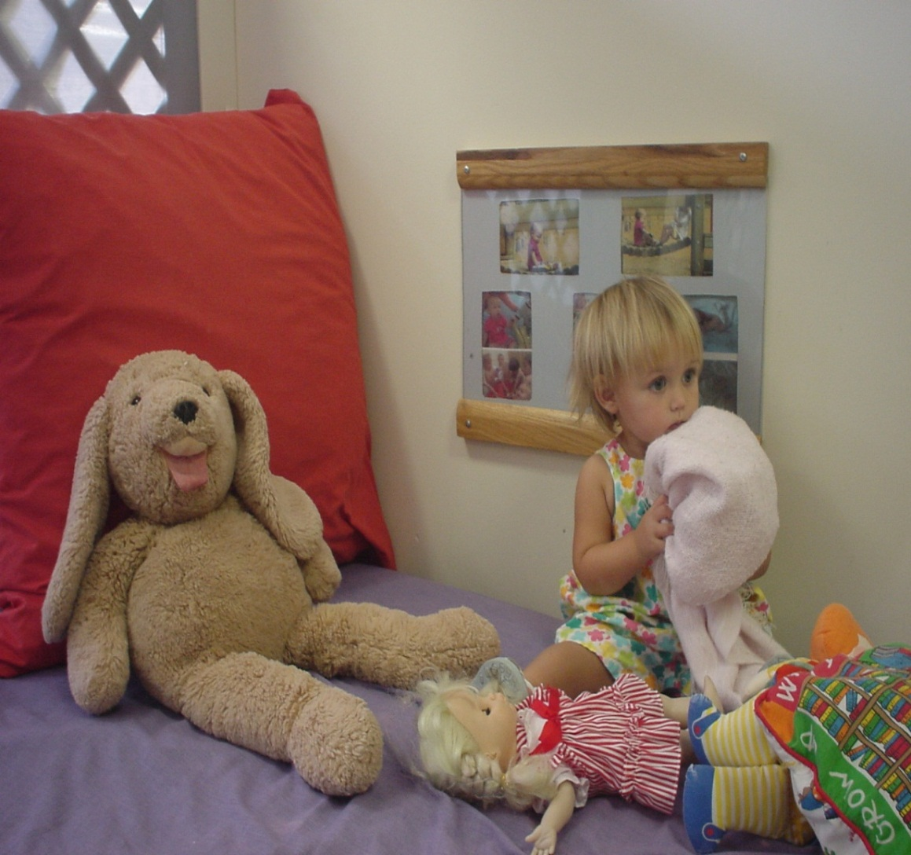
Providing young children a place to
Get Calm and Focused

Slide 3
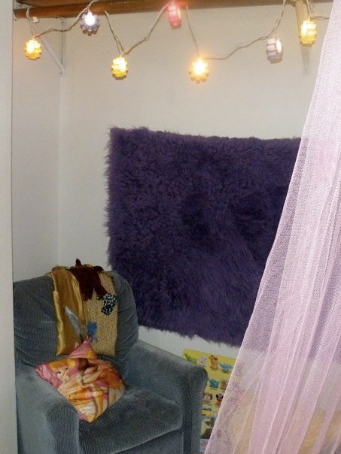
Private Place Center: Design
“Womb” Space
Lighting
  Natural Lighting
  Low light
Visual Boundaries
  Uncluttered spaces
  Substantial dividers
Tactile
  Soft
  Comforting

Slide 4
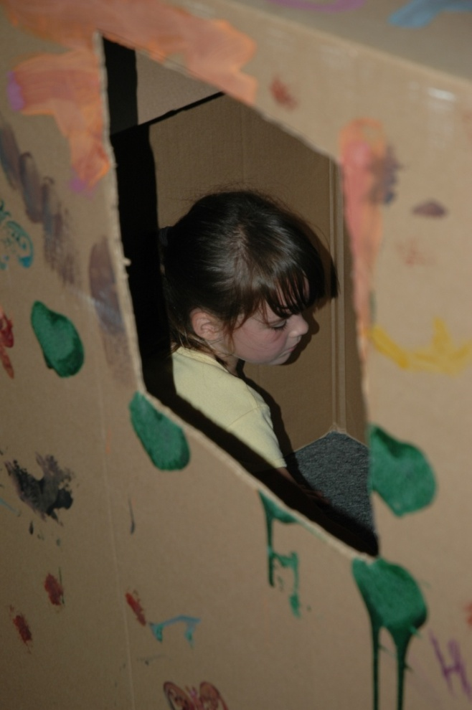
Private Place Center: How to Use
Introduce to children
One child in center
Never used as punishment
Help child learn to effectively use
Identify/label child’s emotion
Return child to previous activity when calm

Slide 5
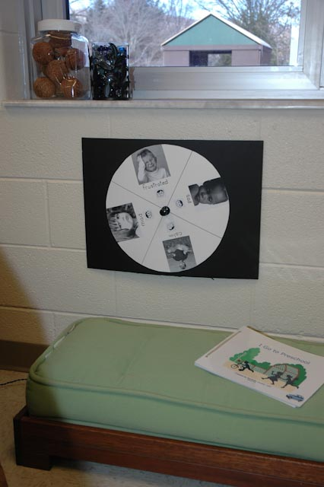
Help child identify Emotions: Wheel of Choice

Slide 6
Private Place Center: Props
Large appliance box, tent or space dividers
Blankets
Pillows or bean bag chairs
Crib mattress or soft bedding
Rhythmic and soft music
Stuffed animals
Flashlight or string lights
Mirror

Slide 7
Books for Private Place
Cain, J. (2000). The way I feel.
Seuss. (1998). My many colored days.
Parr, T. (2001). It’s okay to be different.
Carle, E. (1998). The mixed up chameleon.
Underwood, D. (2010). The quiet book.

Slide 8
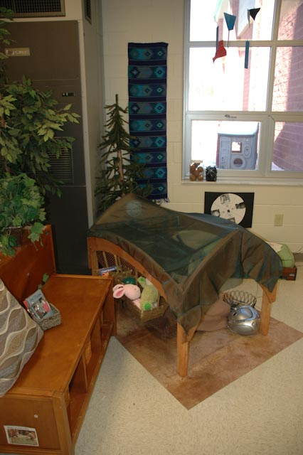
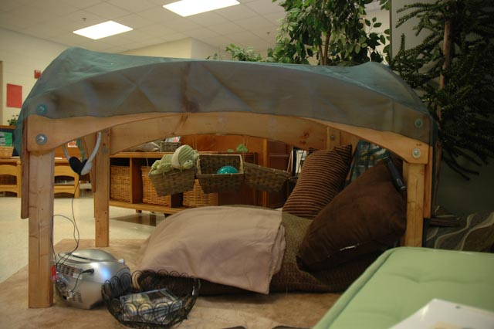
Private Place “OUTDOORS”

Slide 9
